Slide 1

Testing within software development models
Team 1

Slide 2
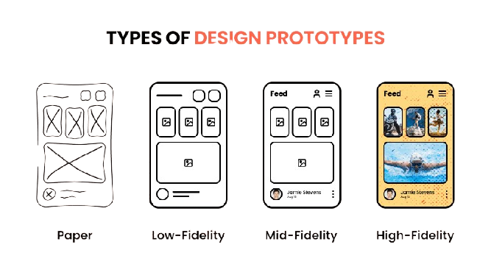
PROTOTYPE

Slide 3
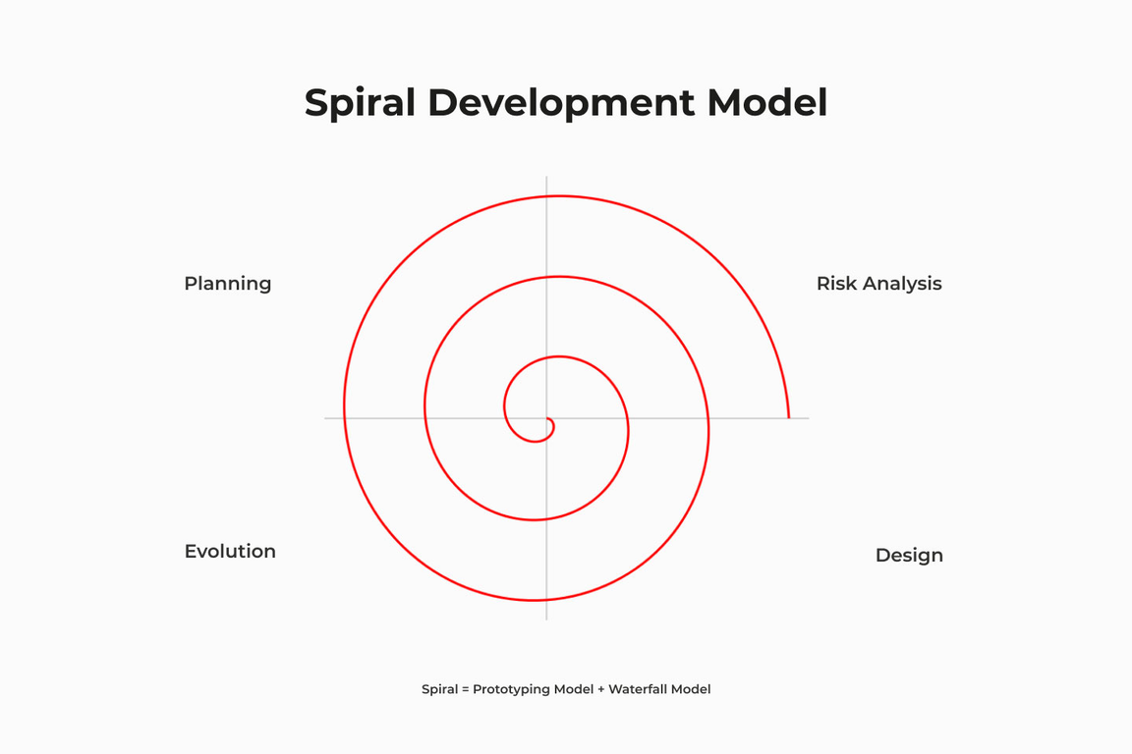
SPIRAL MODEL
The Spiral Model is one of the most important SDLC models, combining the structured approach of the Waterfall Model with the flexibility of the Iterative Model. It is mainly used for risk handling in large and complex projects. The Spiral Model was proposed by Barry Boehm.

Slide 4
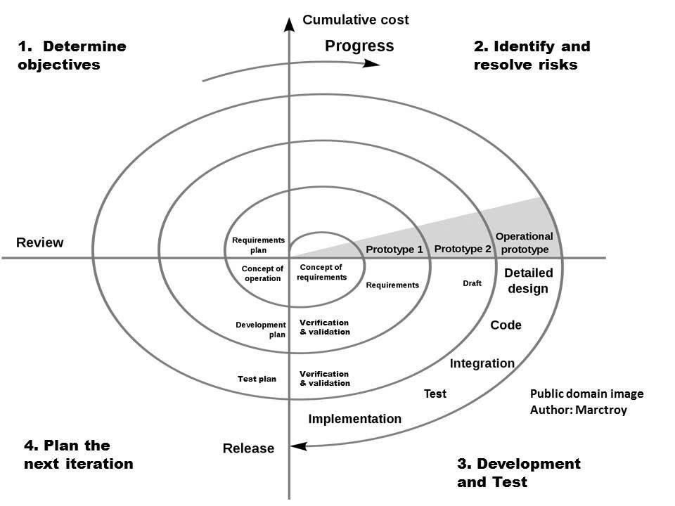

Slide 5
When to use Spiral Model
When risk factor is high in project then this model is perfect to use as more risk evolution is taken place here.
When significant changes and analysis will be required in project then this model is the perfect choice of software development model.
Requirements are not easy and client is not sure for their needs at that time this model can be used.
If project commitment was done for long time then it would be fine to select this model as product development model.

Slide 6
Advantages of Spiral Model
Risk can be handled and different strategy can be applied here to develop a good product.
Documentation needs to be perfect here & good for Log term Project.
Updates and changes can be implemented in middle of the development and software can be identified in the early stage of life cycle.

Slide 7
Disadvantages of Spiral Model
If risk will not be identified then project can be leads to failure.
High cost is required here.
Experience person is required here to resolve the risk so we can’t assign a project to fresher resource.
Can’t implement this mode to small projects.

Slide 8
Does Anyone Have Any Questions?

Slide 9
Thank you

